Slide 1

Legal Clause Analysis (LCA)
In Distributed Computing
Vishwa Ranjan

Slide 2

Agenda
Introduction to LCA
Current Architecture
Problem Statement
LCA in Distributed Computing
Technical Stack
Design & Architecture
ETL Automation Testing Tool
Advantages & Disadvantages
Questionnaire

Slide 3
Introduction to LCA
CDU has an existing ETL component to process XML documents in an agreement family. There are various types of legal agreements like ISDA, PB, REPO etc. An agreement family consists of a master document, multiple annexes and multiple amendments.
Each master/annex/amendment is an individual document. The number of documents in an agreement family can range anywhere between 100-500.
Each document has various legal clauses that need to be processed.
On an average, one can find about 50-100 clauses in a document.

Slide 4
Problem Statement
Processing all the clauses within an agreement family becomes a complex requirement because:
An agreement family can have 100+ documents.
Each document can have 100+ parties and around 100 clauses.
Transformations on the clause attributes can result in more than a million records.
Issues with the legacy system.
Does not support parallel processing.
Average execution time for an agreement family is approximately 10+ hours.
Few agreement families take beyond 100+ hours to be processed.
Impact of this problem
The regulators demand we post & call IM in a timely manner for clients over the threshold. With that threshold decreasing in “waves”, more counterparties are brought into scope and we either have to stop trading with them before the threshold is reached or negotiate IM documentation. When the latter occurs it is necessary to digitize the terms for the risk systems. Further trades cannot be booked without documentation plus the keys that enable margining. With poor performance, this increases the operational risk to the bank.

Slide 5
LCA in Distributed Computing
Requirements for the new solution:
Dynamic parallelism
We wanted to achieve better performance by processing each document in an agreement family in parallel.
Since the number of documents varies with every agreement family, static parallelism would not work.
For the very same reason, the new solution uses spark for in memory cluster computing.
The target for the new solution was not to take more than 15 mins for any agreement family.
The new LCA application allows for the distributed computing of agreement family across multiple computers in a cluster using spark programming models. It is designed to scale up from few machine to a lot of machines each offering local computation and storage. Rather than rely ono hardware to deliver high-availability the library itself is designed to detect and handle failures at the application layer, so delivering a highly-available service on top of cluster computing, each of which may be prone failures.

Slide 6
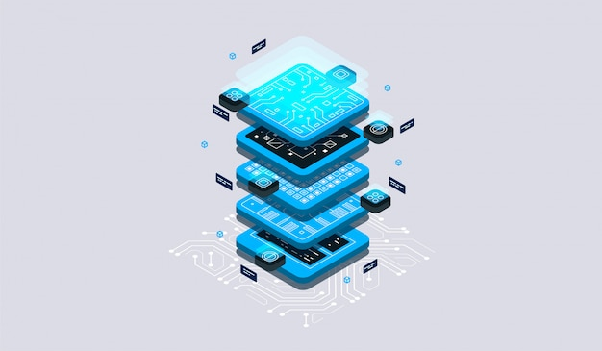
Tech Stack
Apache Spark
Apache Kudu
HDFS
Hive
Apache Kafka
Java
Impala
Livy

Slide 7
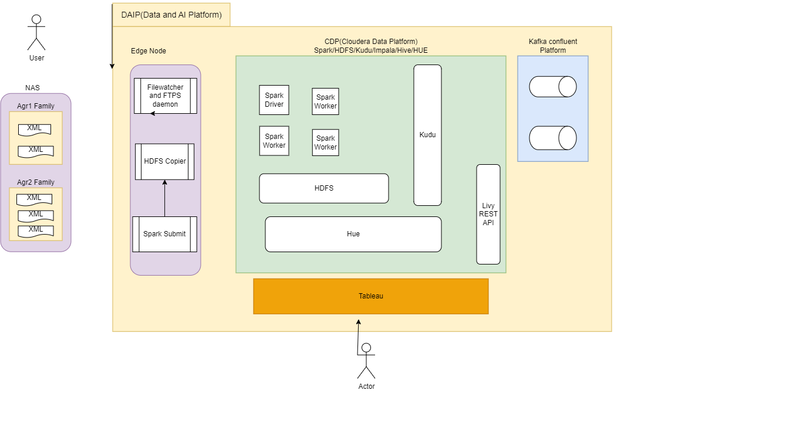
Design and Architecture

Slide 8
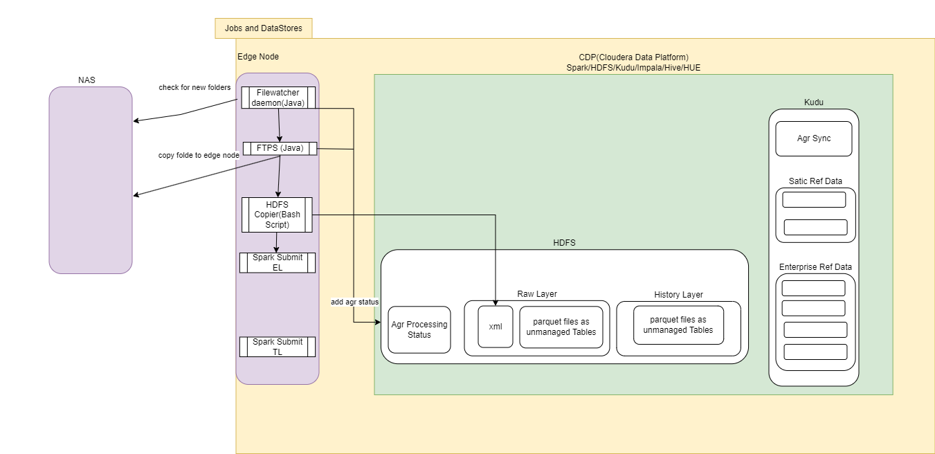
Design and Architecture Contd..

Slide 9
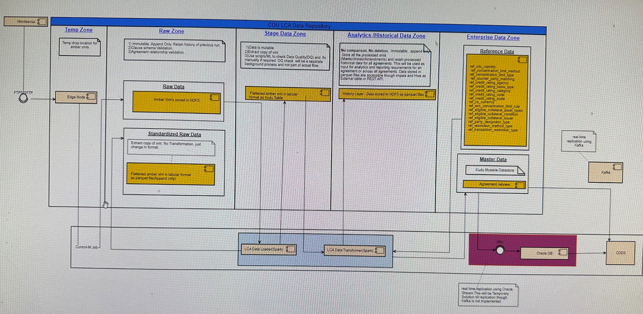
Design and Architecture Contd..

Slide 10
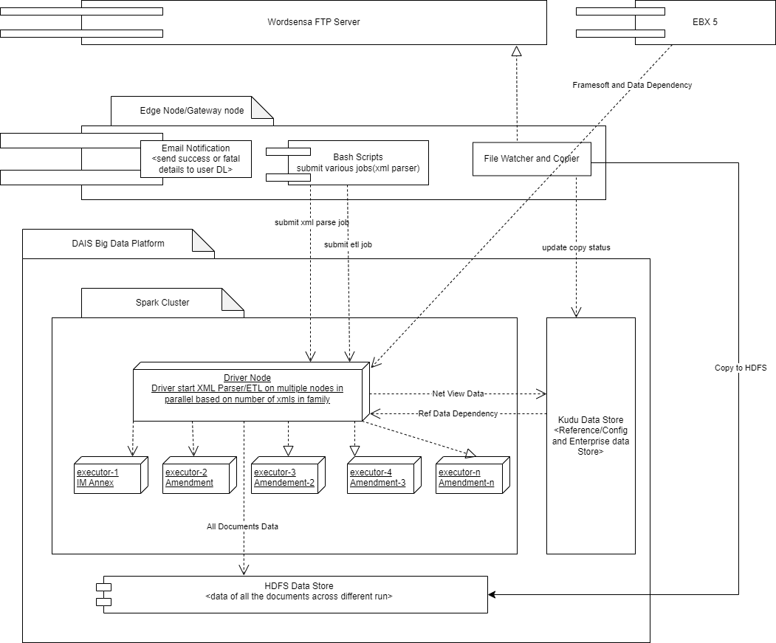
Design and Architecture Contd..

Slide 11
ETL Automation Testing Tool
Automation tool which was built using SQL queries to perform ETL and check the Big data ETL output automatically without any user intervention. This tool is built using SQL, Impala, Unix Scripts and is a collection of 59 different queries and reports all the mismatches, if any, in the reporting table. This has reduced the testing effort by 70%.

Slide 12
Advantages & Disadvantages
Advantages
Dynamic parallel processing system in distributed computing with an average processing time of 8mins.
Few agreement families which was taking more than 100 hours process were getting processing in 15 mins.
Data Driven approach in lots of functionalities, changing the behavior with a tweak of configuration.
Pluggable clause processors with no impact on others whenever processors are added/updated.
Validators with configuration to add/update/remove validations on clause.
Exceptions raised collected into accumulators, and saved into DB for further analysis.
Downstream systems no longer have to wait for a day on an average to get the feed. It is delivered within few mins after processing the documents through Kafka.
Spark UI provides all the details required for debugging.
Disadvantages
Learning curve for the team to understand the complexities of distributed computing and apache spark.
No UI to view the data. (Proposed for next phase)

Slide 13


Slide 14


